Slide 1
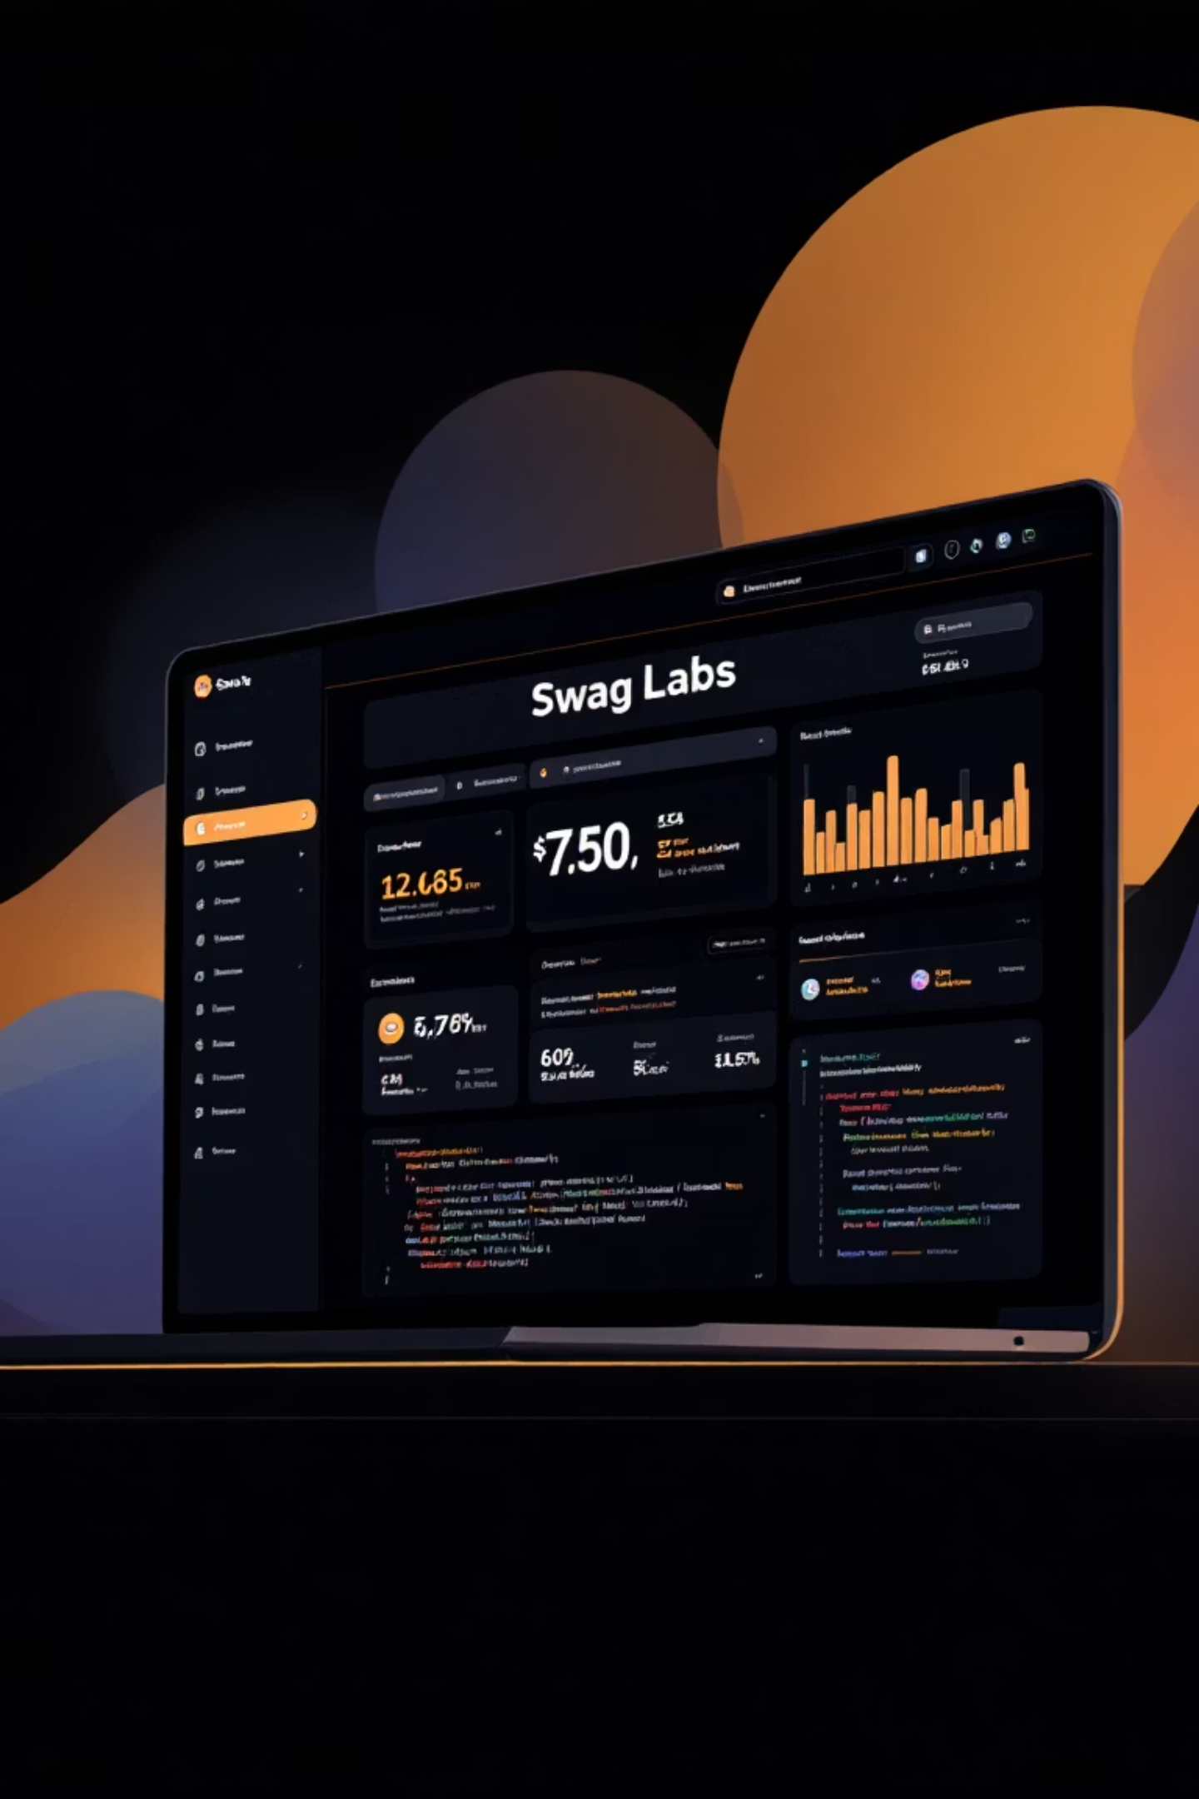
Swag Labs Automation Testing Project
A Complete End-to-End Testing
Presented by: Kancharla Pavan Krishna
Date: 08-09-2025

Slide 2
Links:
Git Hub Link: https://github.com/pavan-krishna-123/CapStone_SwagLabs_Project_Wipro.git
Jira Link : https://pavankrishkancharla1754884219257.atlassian.net/jira/software/projects/SL/boards/34?atlOrigin=eyJpIjoiMGUxMmE1NDM5OGMwNDNiYjkzODFkZWNkMjQ5YzRkNzQiLCJwIjoiaiJ9

Slide 3
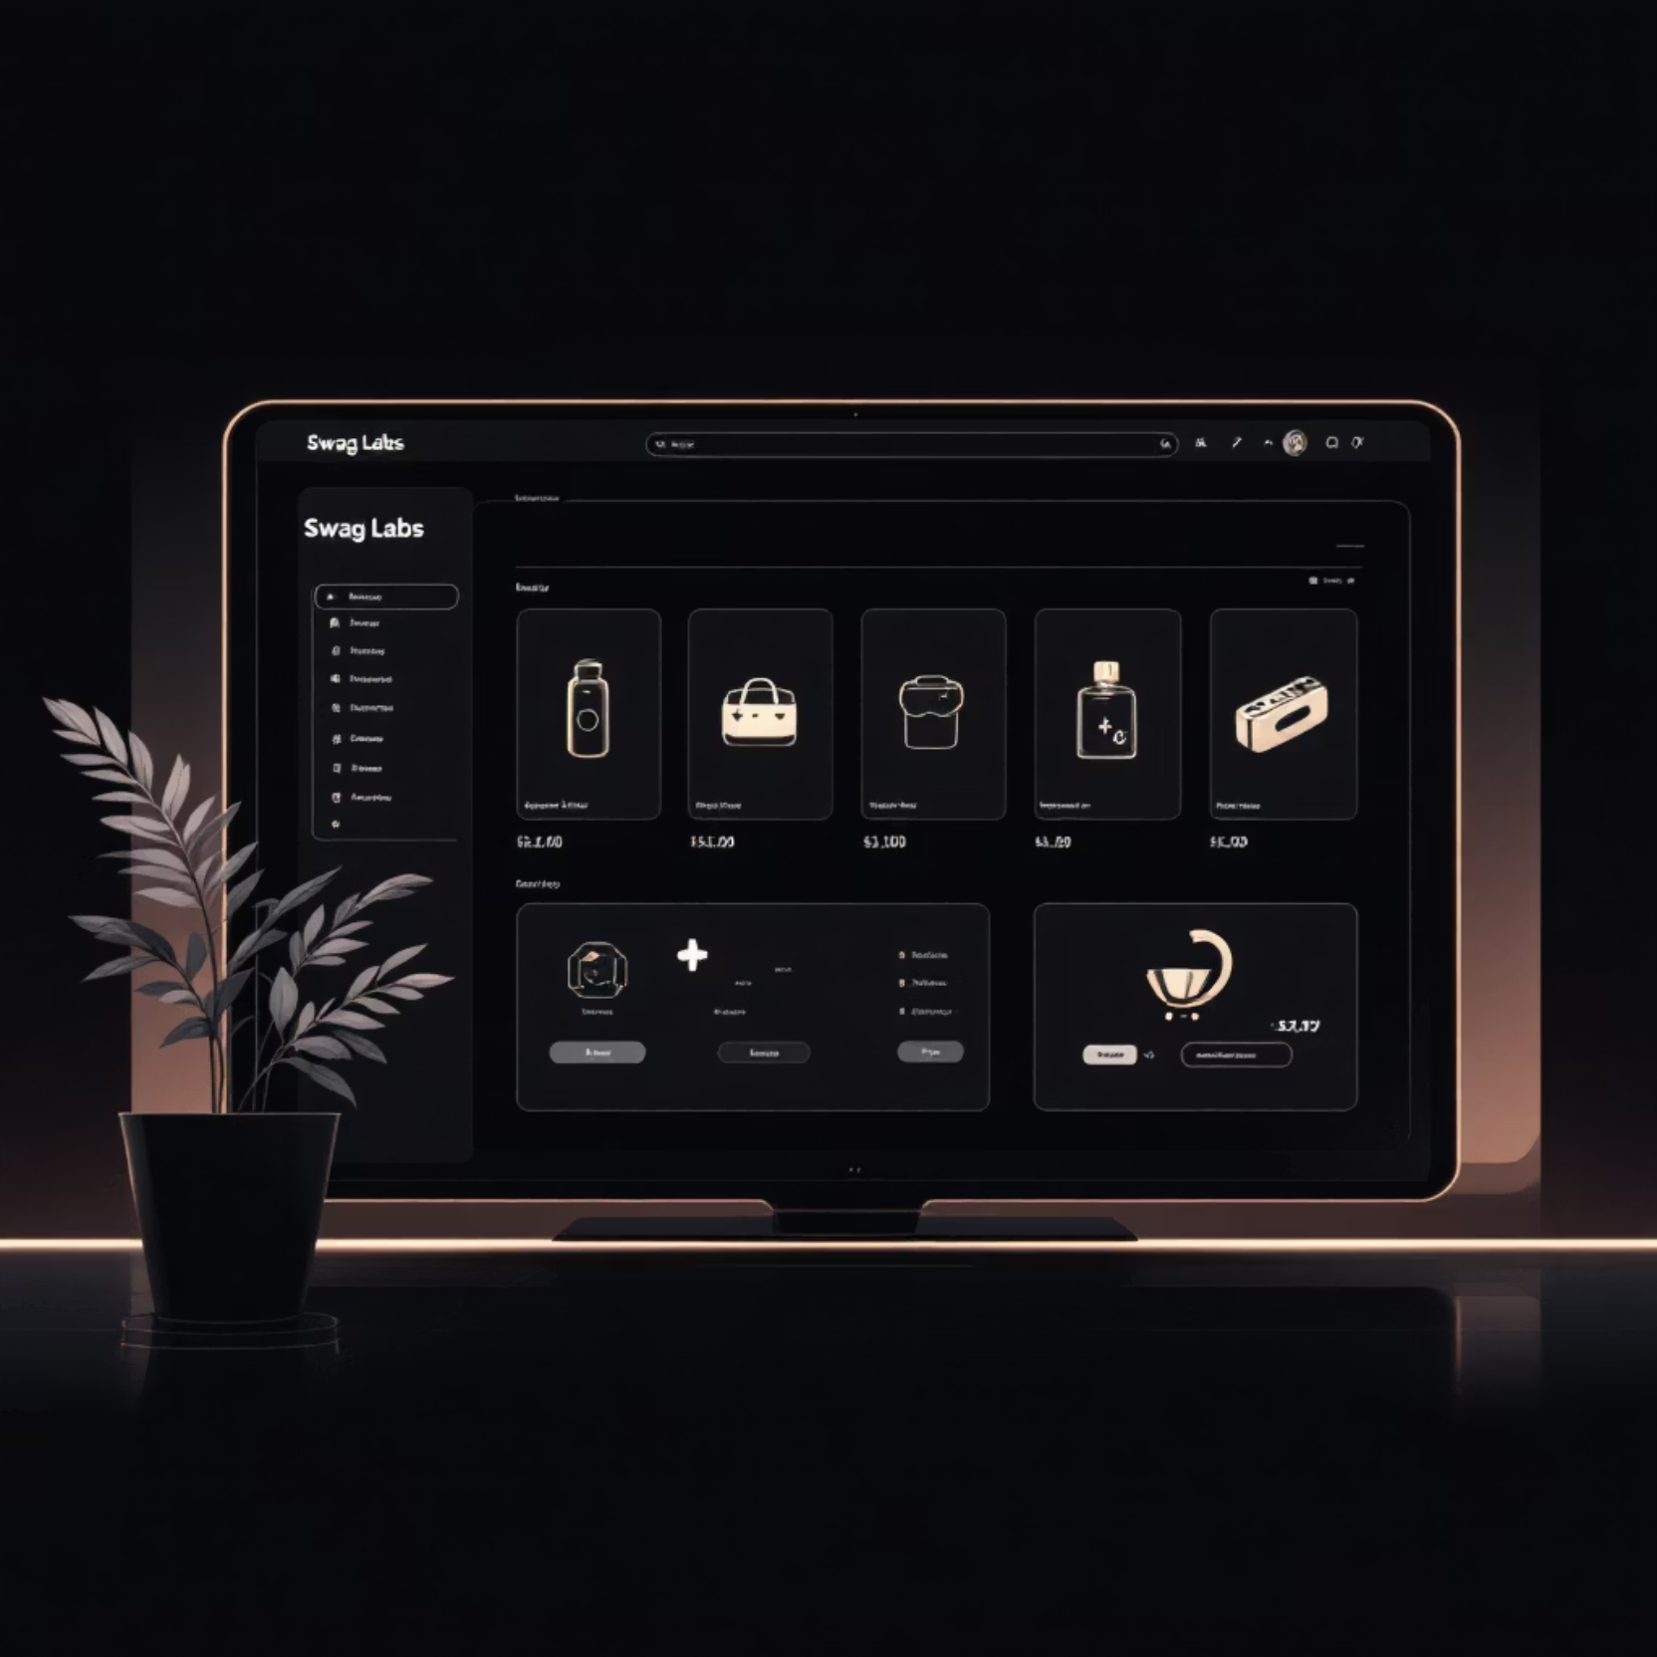
About Swag Labs Website
Swag Labs is a demo e-commerce site for practicing automation testing.
URL: https://www.saucedemo.com
Supports login, product browsing, adding items to cart, checkout, place order etc.
Designed for QA training and automation practice.

Slide 4
Project Overview
Technology Stack
Architecture
Developed using Java, Selenium WebDriver, TestNG, and Maven,Jira,Jenkins.
Implements Page Object Model (POM) for modular structure.
Features
Coverage
Includes utilities for data-driven testing and reporting.
End-to-end test coverage for major flows in the application.

Slide 5
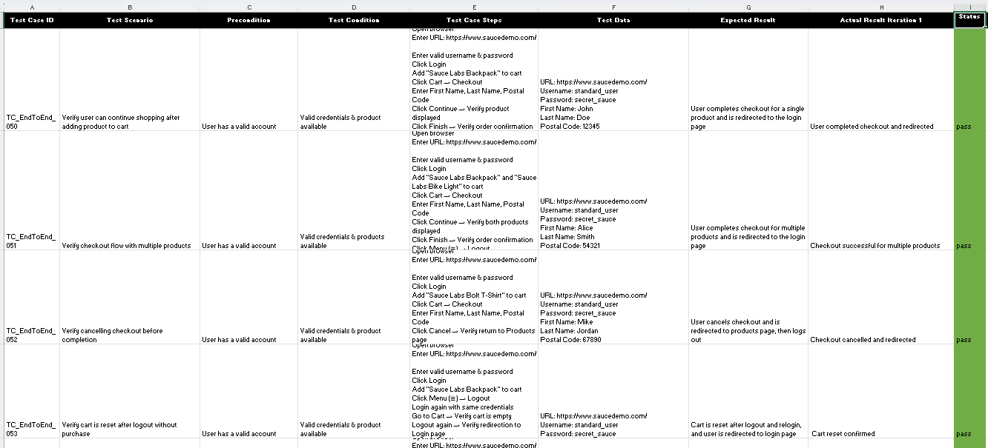
Manual Test cases for End to End Test cases:

Slide 6
Features Implemented
User Authentication
Login validation
Shopping Experience
Product selection and cart management
Purchase Flow
Checkout process validation
Product Navigation
Sorting and filtering functionalities
Error Handling
Screenshot capture on failure
Test Flexibility
Data-driven testing using Excel files
Documentation
Detailed reporting via Extent Reports

Slide 7

Automation Approach
Page Object Model
Test scenarios are mapped to reusable page classes.
Data Management
Data-driven approach using Excel for input values.
Debugging
Logs and screenshots for debugging and traceability.
CI/CD
Continuous integration via Jenkins for scheduled runs.

Slide 8






Project Structure
src/main/java
Core implementation and utilities
src/test/java
Test scripts and scenarios
src/main/resources
Configurations and supporting files
src/test/resources
Test data, reports, screenshots
Maven
Build management and dependency handling
JUnit/TestNG
Test execution

Slide 9








Tools Used
Java
Selenium WebDriver
Programming language
Web automation
TestNG
Maven
Test framework
Build and dependency management
Extent Reports
Jenkins
Reporting
Continuous integration
Jira
Apache POI
Issue tracking and test management
Excel file handling

Slide 10
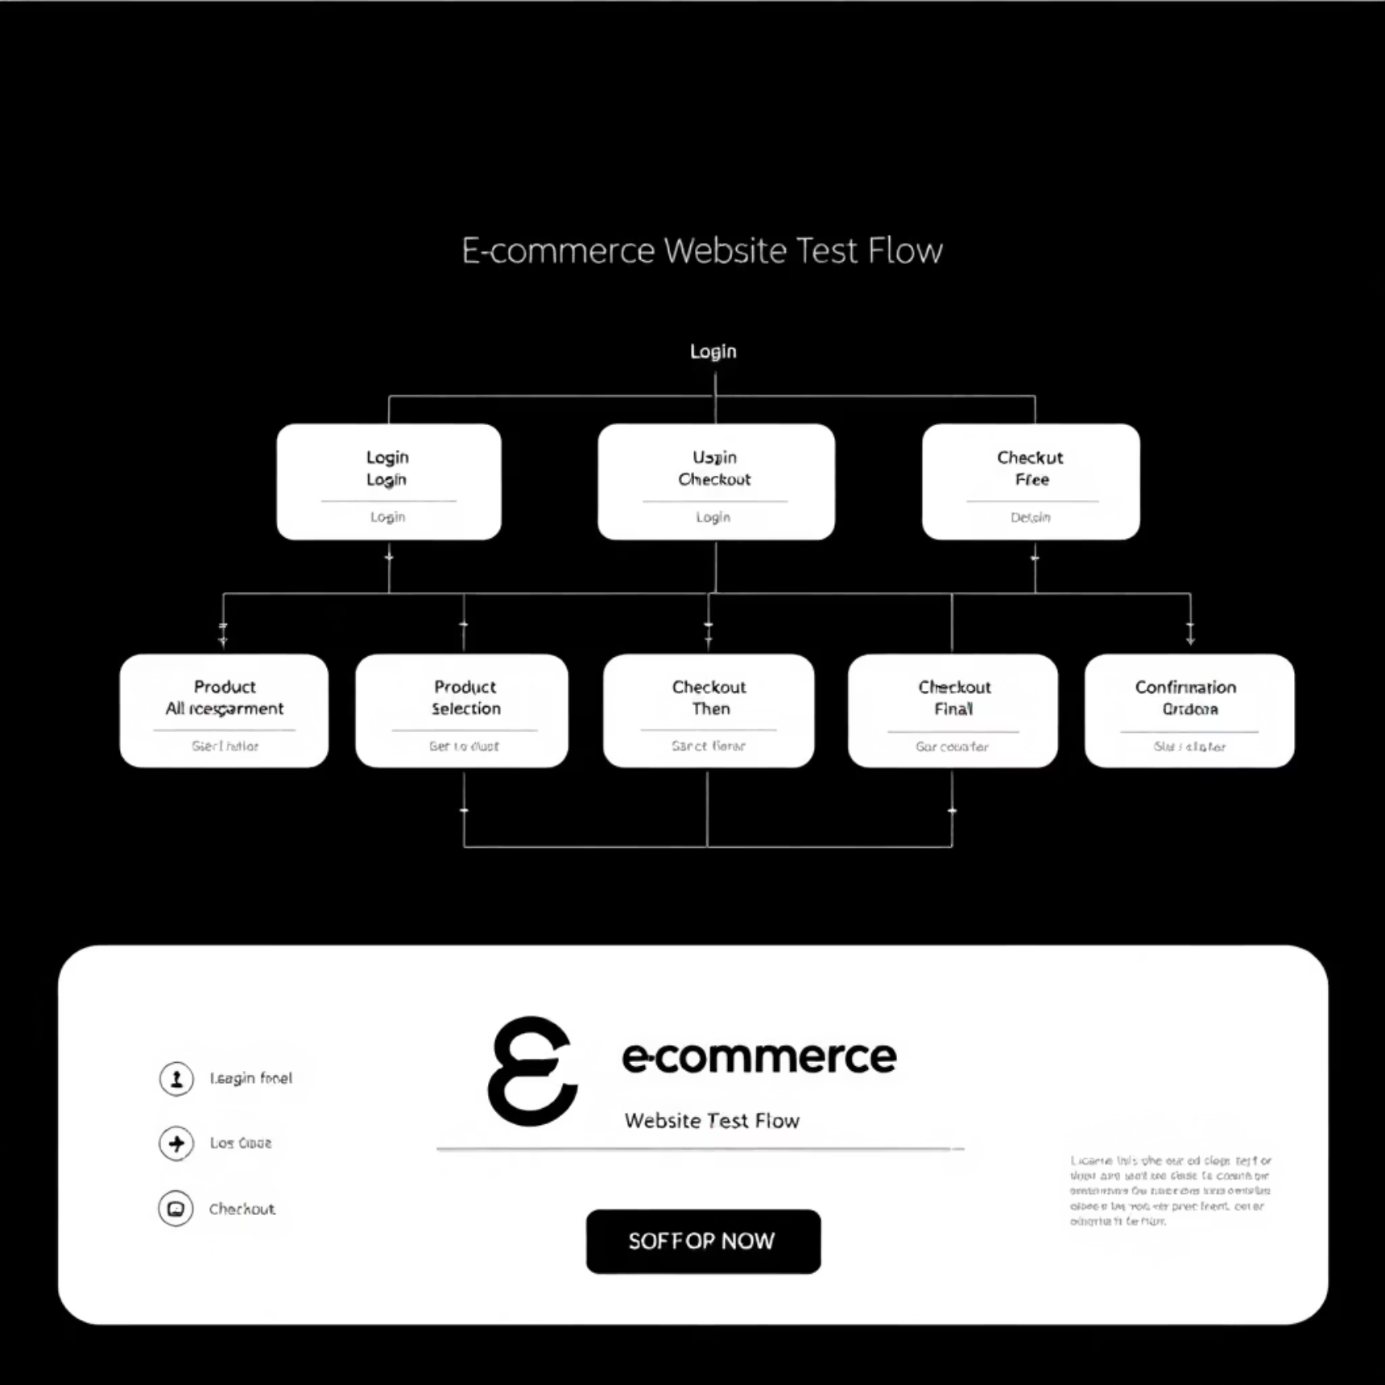
End-to-End Test Cases
01
Login with valid/invalid credentials
02
Add single/multiple products to cart
03
Apply sorting and verify results
04
Checkout process validation
05
Cancel checkout and verify redirection
06
Cart persistence after logout
07
Complete purchase flow with order confirmation

Slide 11

Test Data Management & Challenges
Test Data Management
Challenges Faced
Handling dynamic elements and page load times
Test data stored in Excel files for flexibility
Synchronization between test steps and application state
Input includes usernames, passwords, names, and postal codes
Managing test data and multiple test cases efficiently
Data-driven tests allow multiple scenarios with the same script
Integrating reporting and logging mechanisms
Helps in validating edge cases without changing the code
Ensuring stability across browsers and network conditions

Slide 12




Integration & Reporting
Reports and Logging
Jenkins Integration
Extent Reports integrated for interactive dashboards
Used Freestyle project to automate test execution
Logs capture each test step with timestamp and status
Configured build steps to run Maven commands and execute TestNG tests
Screenshots taken for failures for better debugging
Test results and reports archived as build artifacts
Reports archived in test directories for historical reference
Scheduled periodic test runs using Jenkins triggers
Jira Implementation
Test Results & Conclusion
Test cases tracked as issues for transparency
All major test cases passed successfully
Defects linked to test execution results
Reports generated with detailed logs and screenshots
Sprint planning and defect management integrated with test reporting
The Swag Labs Automation Project provides a robust framework for web testing
Helps teams collaborate and prioritize tasks effectively
Enhances testing accuracy, efficiency, and scalability

Slide 13
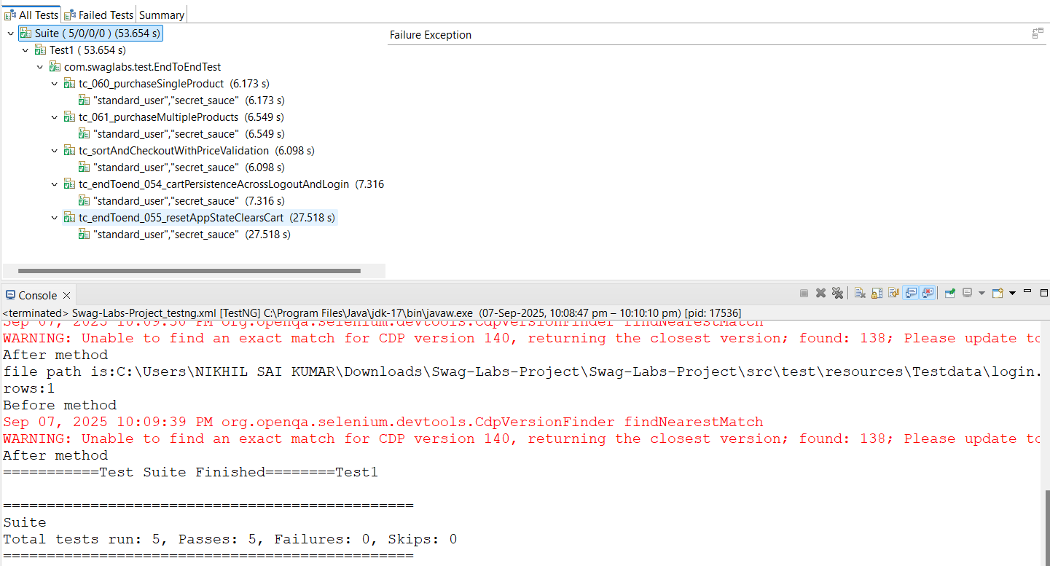
Results of Testng:

Slide 14
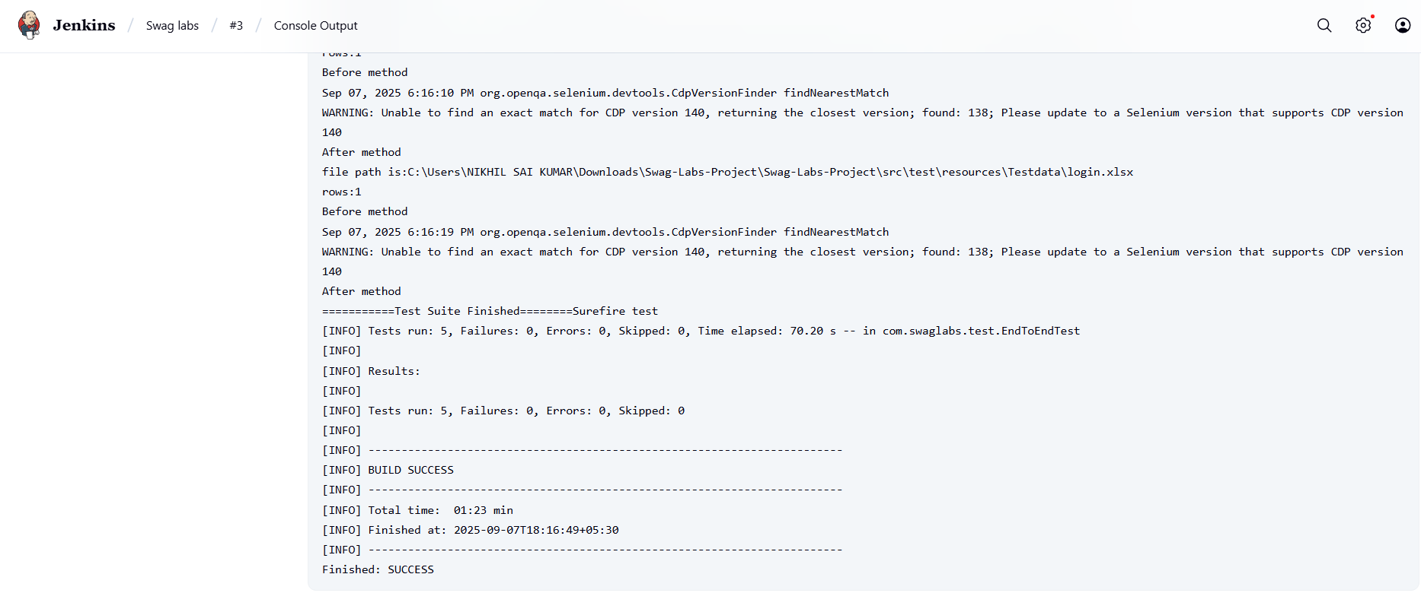
Results of Jenkins:
Results of Testng:

Slide 15
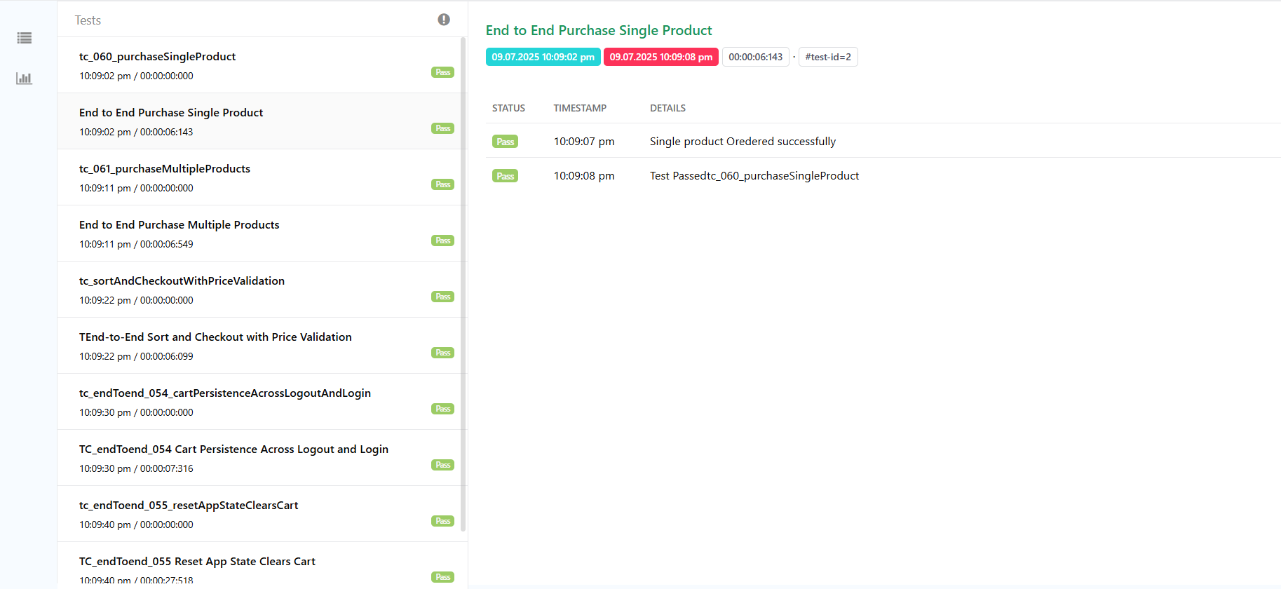
Results of Extents Reports:

Slide 16
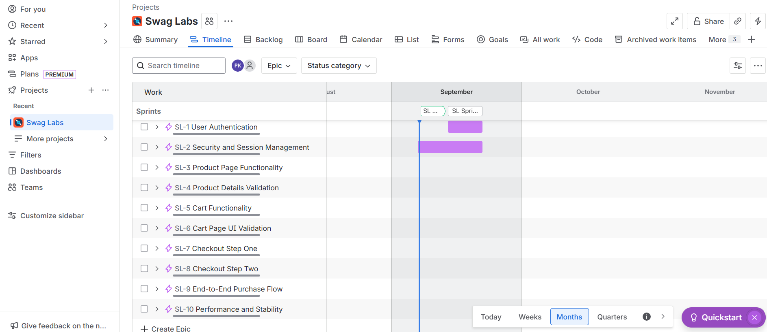
Epic & Stories of Jira:

Slide 17
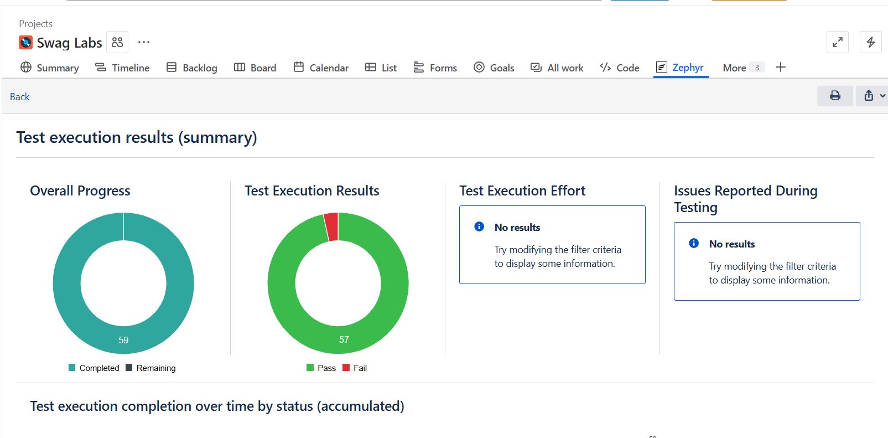
Test Execution Results in Jira:

Slide 18
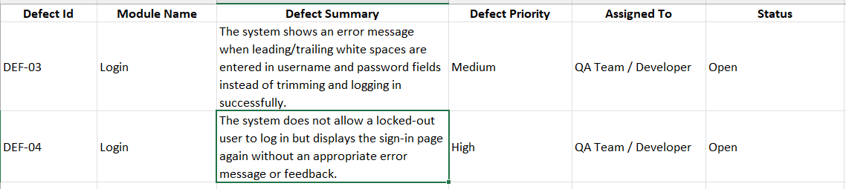
Defect Report:

